Slide 1

Employee Data Analysis using Excel
STUDENT NAME: VIGNESH.C
REGISTER NO: 312207343
DEPARTMENT: COMMERCE
COLLEGE: C.KANDASWAMI NAIDU COLLEGE FOR MEN

Slide 2

PROJECT TITLE
EMPLOYEE DATA ANALYSIS INTO STRATEGIC ADVANTAGE using Excel

Slide 3


AGENDA
Problem Statement
Project Overview
End Users
Our Solution and Proposition
Dataset Description
Modelling Approach
Results and Discussion
Conclusion
3/21/2024 Annual Review

Slide 4

PROBLEM STATEMENT
Employee data analysis is a powerful tool that helps organizations uncover trends, optimize workforce management, and make evidence-based decisions to improve overall efficiency and employee satisfaction."
Performance Optimization : By analyzing employee performance data, organizations can identify top performers, pinpoint areas for improvement, and tailor training programs to enhance overall productivity. Retention and Engagement : Employee data analysis helps identify patterns in turnover, allowing companies to address factors contributing to employee dissatisfaction and improve retention strategies.

Slide 5

PROJECT OVERVIEW
The primary goal of this project is to leverage employee data analysis to enhance workforce management, optimize productivity, and support strategic decision-making within the organization. By systematically collecting, analyzing, and interpreting employee data, the project aims to uncover actionable insights that will drive improvements in employee performance, retention, and overall organizational efficiency.

Slide 6


WHO ARE THE END USERS?
Human Resources (HR) Department: - HR Managers and Specialists: Use data to manage recruitment, retention, training, and employee engagement strategies. - Talent Acquisition Teams: Leverage data to refine hiring practices, identify skill gaps, and forecast future staffing needs. - Compensation and Benefits Analysts:
Analyze data to design competitive compensation packages and benefits that align with employee needs and market standards. 2. Executive Leadership: - CEOs and Executives: Utilize data insights for strategic planning, resource allocation, and setting organizational goals related to workforce management. - Chief Human Resources Officer (CHRO): Uses data to drive HR strategy, improve organizational culture, and align workforce initiatives with business objectives. - Chief Diversity Officer (CDO): Analyzes diversity metrics to implement and track progress on diversity and inclusion initiatives.

Slide 7

OUR SOLUTION AND ITS VALUE PROPOSITION
*Solution Overview:*The Employee Data Analysis Solution is a comprehensive platform designed to collect, process, and analyze employee data to provide actionable insights that enhance workforce management. The solution integrates various data sources, including HR systems, employee surveys, performance management tools, and payroll systems, into a centralized analytics platform. By leveraging advanced analytics, machine learning, and data visualization, the solution enables organizations to make data-driven decisions that improve employee engagement, performance, and retention. *Key Features: 1. *Data Integration and Centralization:* - Seamlessly integrates data from multiple sources, providing a holistic view of the workforce. - Ensures data consistency and accuracy through automated data cleansing and validation. 2. *Advanced Analytics and Reporting:* - Utilizes predictive analytics to forecast workforce trends, such as turnover rates and skill shortages. - Provides detailed reports and dashboards that visualize key metrics, such as employee engagement, productivity, and diversity. 3. *Real-Time Monitoring:* - Offers real-time analytics to monitor employee performance and engagement, enabling timely interventions. - Tracks the effectiveness of HR initiatives and programs, allowing for continuous improvement.

Slide 8
Dataset Description
Dataset Description: Employee Data AnalysisThe employee data analysis dataset is a comprehensive collection of data points that reflect various aspects of an organization’s workforce. This dataset is crucial for conducting in-depth analyses to improve employee management, performance, and overall organizational efficiency. Below is a detailed description of the key components typically found in such a dataset: 1.Employee Demographics: - *Employee ID:* A unique identifier for each employee. - *Name:* Full name of the employee (can be anonymized for privacy). - *Age:* The age of the employee. - *Gender:* Gender of the employee. - *Ethnicity:* Ethnic background of the employee. - *Marital Status:* Marital status (e.g., single, married, divorced). - *Education Level:* Highest level of education attained (e.g., high school, bachelor’s degree, master’s degree). 2. Employment Details:* - *Department:* The department or team the employee is assigned to. - *Job Title:* The employee’s current job title or position. - *Date of Hire:* The date the employee was hired. - *Employment Type:* Full-time, part-time, contract, or temporary. - *Work Location:* The primary location where the employee works (e.g., office, remote, branch location). - *Supervisor ID:* ID of the employee’s direct supervisor. 3. Compensation and Benefits:* - *Salary:* The base salary of the employee. - *Bonuses:* Total amount of bonuses received in a given period. - *Benefits Package:* Information about benefits received, such as health insurance, retirement plans, and stock options. - *Overtime Hours:* Number of overtime hours worked by the employee. - *Commission:* Commission earned, if applicable. 4. Performance Data:* - *Performance Ratings:* Ratings from performance reviews (e.g., on a scale of 1-5). - *KPIs (Key Performance Indicators):* Specific metrics used to measure employee performance. - *Goals Achieved:* Number or percentage of performance goals met within a given period. - *Training Completion:* Record of completed training sessions or certifications. - *Project Involvement:* List of projects the employee has worked on, along with their roles and contributions. 5. Attendance and Leave:* - *Attendance Record:* Data on days present, absent, and tardy. - *Sick Leave:* Number of sick days taken. - *Paid Time Off (PTO):* Total days of paid time off used. - *Unpaid Leave:* Number of days taken as unpaid leave.

Slide 9

THE "WOW" IN OUR SOLUTION
1. AI-Powered Predictive Analytics:* - *Future-Proof Workforce Planning:* Leverage AI and machine learning algorithms to predict future workforce trends, such as emerging skill gaps, potential employee attrition, and evolving job roles. This allows organizations to proactively prepare for changes and stay ahead of the competition. - *Personalized Career Pathing:* The solution can recommend personalized career paths and development opportunities for each employee based on their skills, performance, and aspirations, boosting engagement and retention. 2. Real-Time Sentiment Analysis:* - *Emotion Recognition:* Integrate sentiment analysis powered by natural language processing (NLP) to gauge employee emotions from feedback, emails, or survey responses in real-time. This enables immediate response to potential issues, improving employee satisfaction and preventing conflicts. - *Engagement Heatmaps:* Visualize employee engagement across departments or teams through dynamic heatmaps, highlighting areas of high and low morale.
3/21/2024 Annual Review
9

Slide 10
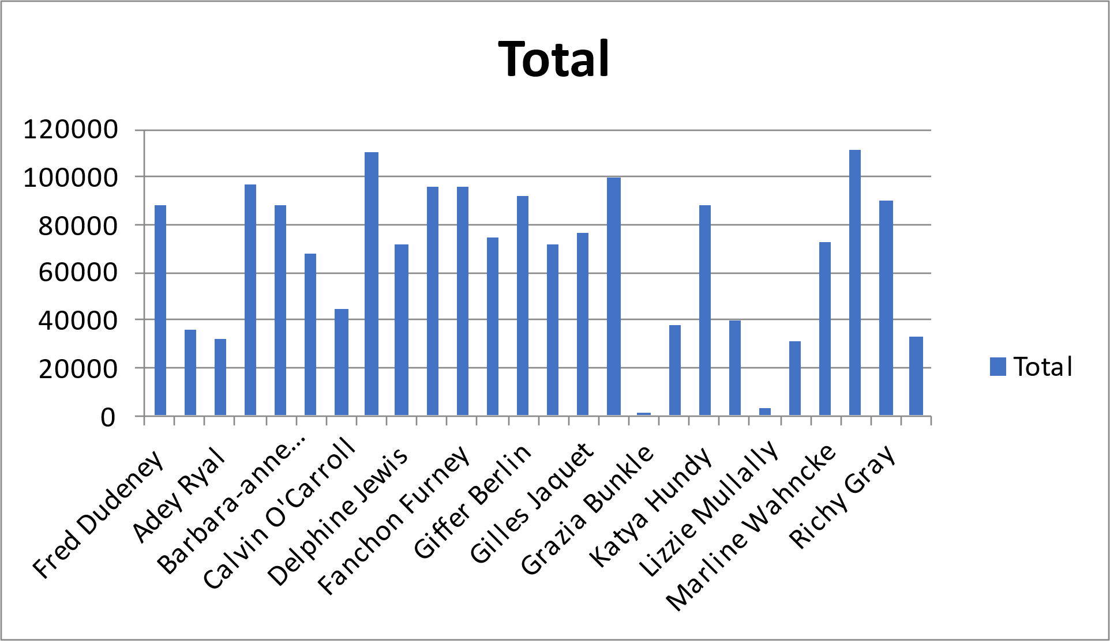

MODELLING
Row Labels | Sum of Salary
Fred Dudeney | 88689.09
Jamesy O'Ferris | 36547.58
Adey Ryal | 32496.88
Aluin Churly | 96555.53
Barbara-anne Kenchington | 88034.67
Barr Faughny | 68008.55
Calvin O'Carroll | 44447.26
Carlin Demke | 110042.37
Delphine Jewis | 71823.56
Easter Pyke | 95677.9
Fanchon Furney | 95954.02
Faun Rickeard | 74924.65
Giffer Berlin | 92336.08
Gilda Richen | 71924.85
Gilles Jaquet | 76303.82
Granny Spencelayh | 99460.78
Grazia Bunkle | 1000
Jo-anne Gobeau | 37902.35
Katya Hundy | 88511.17
Layton Crayden | 40445.29
Lizzie Mullally | 3000
Mabel Orrow | 31241.24
Marline Wahncke | 72843.23
Michale Rolf | 111815.49
Richy Gray | 89829.33
Thorvald Milliken | 33031.26
Grand Total | 1752846.95
10

Slide 11
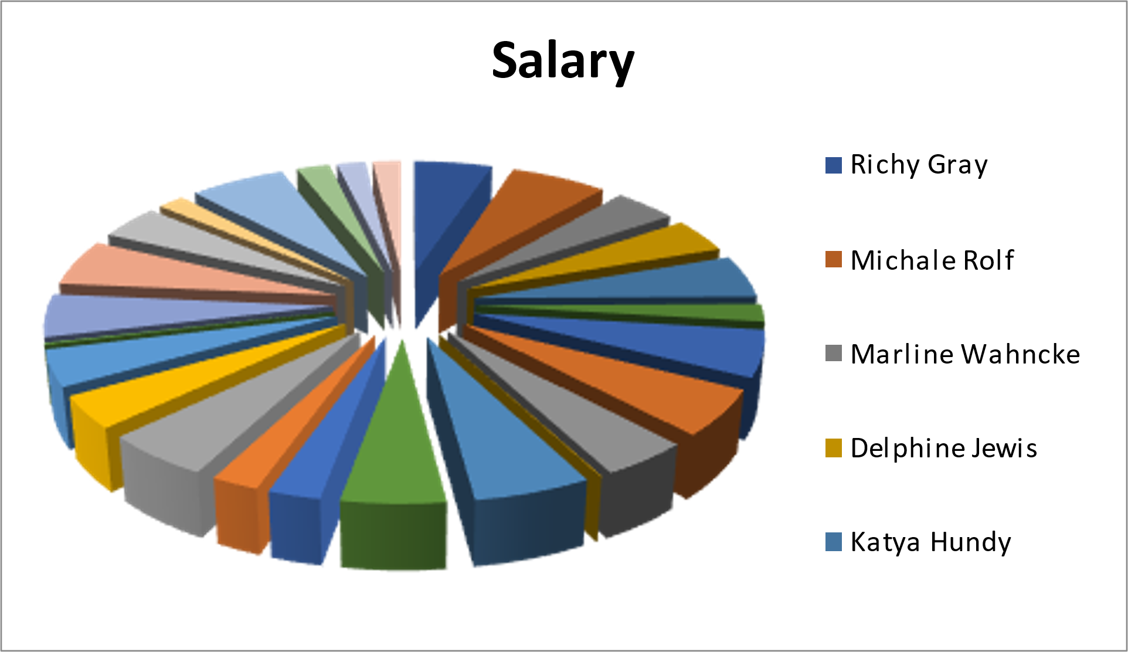
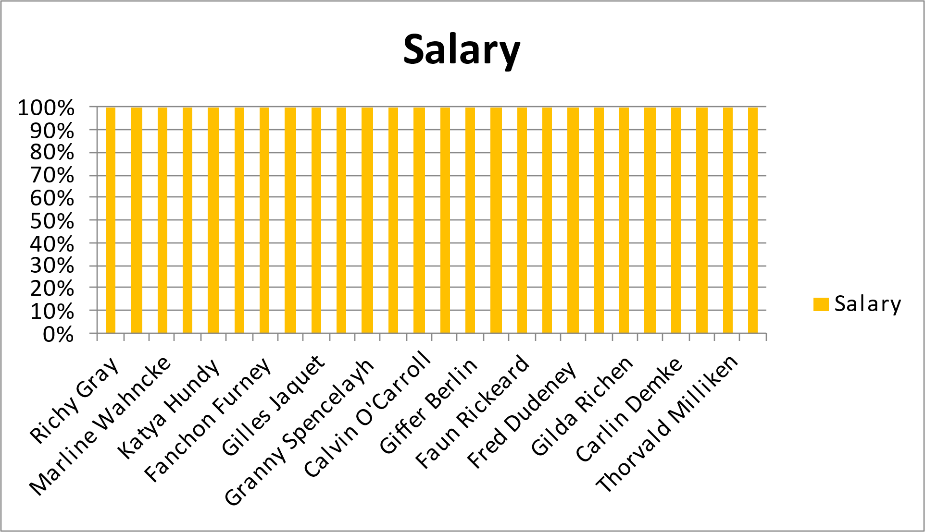
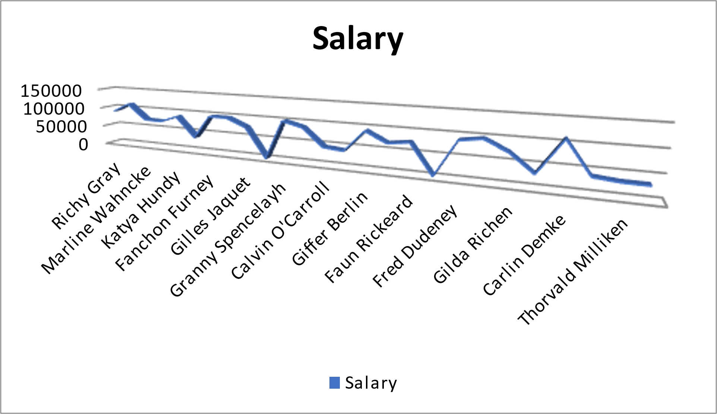
RESULTS
11

Slide 12
conclusion
Employee data analysis is a powerful tool that enables organizations to unlock valuable insights into their workforce, driving better decision-making, improved employee engagement, and enhanced productivity. By leveraging data effectively, companies can not only optimize their talent management strategies but also foster a more supportive and dynamic work environment, ultimately leading to sustained business success.

